Slide 1
Cricket Shot Detection
BYTE CRUNCHERS

Slide 2
Model Architecture
Media Pipe Pose Detection
Pose Detection
x,y,z and visibility = 4
Unpacked across 33 points = 132(33*4)
Face Detection
x,y,z =3
Unpacked across 468 points = 1404(468*3)
Left Hand Detection
x,y,z =3
Unpacked across 21 points = 63(21*3)
Right Hand Detection
x,y,z =3
Unpacked across 21 points = 63(21*3)
Totally 132+1404+63+63 = 1662 Points

Slide 3
Model architecture (Cont)
Given a frame we calculate the co-ordinates of 1662 points
For training we split a video to thirty frames and send it to model for prediction of action(Pre-Stance,Stance,Straight Drive,Pull shot) based on these 1662 points across 30 frames in a video.
So input to the model is 30*30*1662 per action(i.e 30 Videos per action with 30 frames per video and 1662 points per frame)

Slide 4
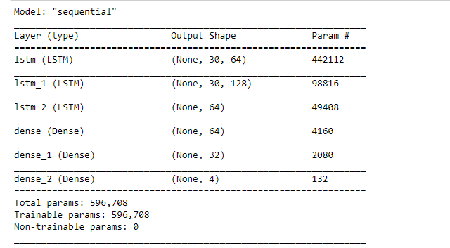
LSTM model
Input to the model(30 Frames * 1662 body points)

Slide 5
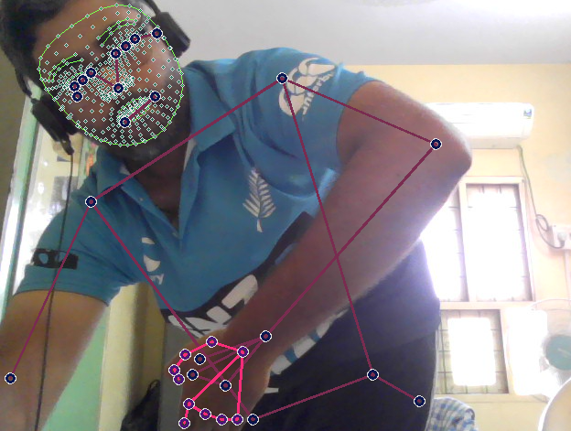
Training Data Generation

